Slide 1
Green Plana
Creating green community of tomorrow

Slide 2
Green Plana
Get ahead of the trend
Build-your-own-house approach
Innovative Development

Slide 3
Ownership Structure
Green Project &Finance Ltd
Owner/Sponsor
EUR 25 million
Green Plana EOOD
Project Company

Slide 4
The Business Model
We sell land plots to individual investors so they can build their own houses
We take care of the coherent architectural design of the houses and the whole project
We will develop the engineering infrastructure, financed by the residents
We will stay as services provider when the project is fully developed

Slide 6
Project Overview
Innovative Development:
enabling investors to build their own houses by keeping coherent design of the project
Infrastructure and construction will be financed by the individual investors
Concept:
creating a green community of about 500 families at first stage by providing necessary services and infrastructure
Invested Equity:
about EUR 25 million
Asset:
About 2,000 decars of urbanised land with no encumbrances or liens
Location:
next to the village of Plana - half an hour from Sofia, 20 minutes from Borovets Ski Resort, 10 minutes from Belchin Banya Spa Resort and Iskar lake

Slide 7
The Project on Individual Level
Innovative Approach:
Build-your-own-house approach
Land plots of minimum 500 m² – flexible size of the individual investment i.e. the smallest size of property will be comparable as an amount invested to an average apartment in Sofia
Coherent external appearance of the project – 15 to 20 models of house designs
Coherent socio-economic profile of residents – middle and upper-midle class
Time span of up to 5 years for building the houses
Excellent investment opportunities – early buyers can expect great appreciation of their rather modest investment in 5 to 7 years horizon

Slide 8
The Project on Individual Level
The Aim Is Serviced Community:
In the property there is an existing water supply and electricity line
Development of technical infrastructure – water supply and sewage (local waste water treatment plant), electricity, roads, telecommunication
Development of social infrastructure – kinder garden, community centre, shops, sport facilities (spa, gym, tennis court) medical cabinet etc.
Maintenance of common parts
Value added transportation services – in addition to the existing bus line we would provide shuttle to Sofia city centre each 30 minutes with an itinerary customised to the requirements of residents

Slide 9
Marketing Approach
On Domestic Market:
Green Plana Ambassadors – opinion makers in different professional communities (bankers, lawyers, accountants, IT professionals, doctors etc.) will be offered the opportunity to come as groups of 10-20 individual investors with special discount price
Bulgarian genuine clients – age 30 - 45
On Foreign Markets:
Israel – 100 reservation fees paid by potential investors
Russia – diversifying the products offered - Bulgarian property with a new profile will be offered
Gulf Area, England, Austria, Spain – communities with interest for living in Bulgaria from the third age.

Slide 10
Current Status
Approximately EUR 25 million Euro has been invested so far
The property being about 2,000,000 m² has a valid detailed zoning plan (PUP)
The land is fully owned by the project company with no encumbrances or liens
Land value today – EUR 35 per m² (valuation done by CBRE)
Building rights for more than 2.4 million m²
500 plots will be sold as first step to Build Your Own Home type of individual investors
3000 houses are planned in several steps

Slide 11
Competitive Advantages of the Project
Prime location within exclusive green area
225 days of sun
An opportunity for 150 m² house on 500 m² plot for a price of about EUR 80,000
A house for the price of an apartment
Exclusive gated community which provides security and quality of life
Full modern infrastructure
Community services and leisure facilities
Unique product that does not exist in Bulgaria

Slide 12
SWOT Analysis
Strengths | Weaknesses
Excellent location – near Sofia, Borovets ski resort, Belchin banya spa resort and Iskar lake; Unique climate conditions – 225 sunny days a year; No construction risk; Innovative product; Innovative marketing approach; Serviced green community with unique quality of life assured – the developer is as well services provider. | Ahead of the current market; A bit far from the city centre of Sofia for currently prevailing public perceptions – 30 minutes drive; Lack of engineering and social infrastructure.
Opportunities | Threats
Ahead of the current market – excellent growth potential for both early bird individual and financial investors; Customised energy efficient eco friendly house on price comparable to the one of an apartment in Sofia; Active life style within a community sharing common values; Construction process of individual houses might last up to 5 years according to the best convenience of the investors. | Long lasting construction process for individual houses; The construction of infrastructure is planned in stages.

Slide 13
Handling Threats and Weaknesses
Attractive penetration price is the adequate tool to deal with ahead of market situation
Private shuttle with customised itinerary, provided by the service company would change the perception of the distance
Managing the project development in phases would limit the inconveniences for the residents related to the construction process
Depending on the number of residents the infrastructure will either rely on the village of Plana or an autonomous system will be developed

Slide 14
Senior Management
Initiator, President of Green Plana – Mr. Avinoam Katrieli
Vice Presidents – Mr. H. Alkobi, Mr. O. Dori
Project Manager – Mr. E. Magrisso
Consultants:
Marketing Advisor – Mr. E. Egozi
Financial and Banking Advisor – Mr. Y. Yordanov, Mr. T. Hume
Legal Advisers – Adv. B. Etzion, Israel, Adv. D. Nikolova, Bulgaria
Project Architects – S Architectural Team Ltd., Mr. Lubumir Stanislavov

Slide 15
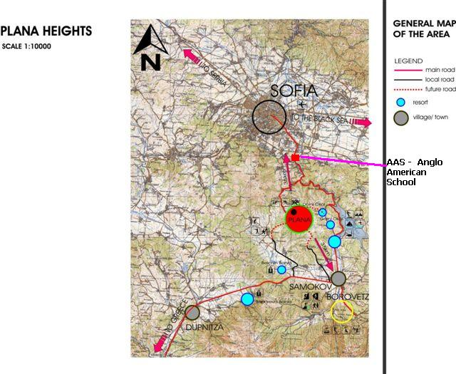

Slide 16
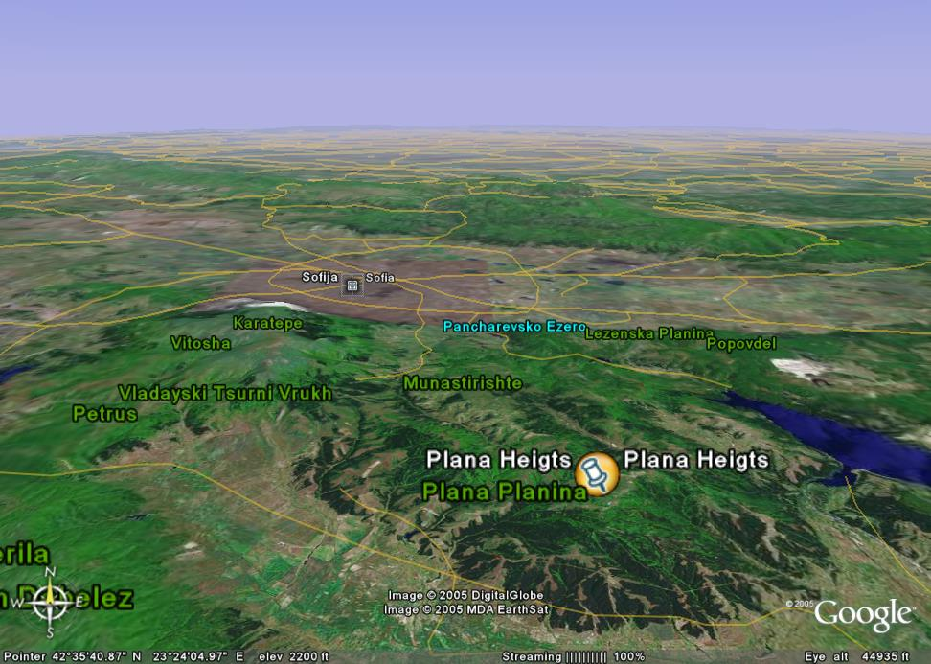

Slide 17
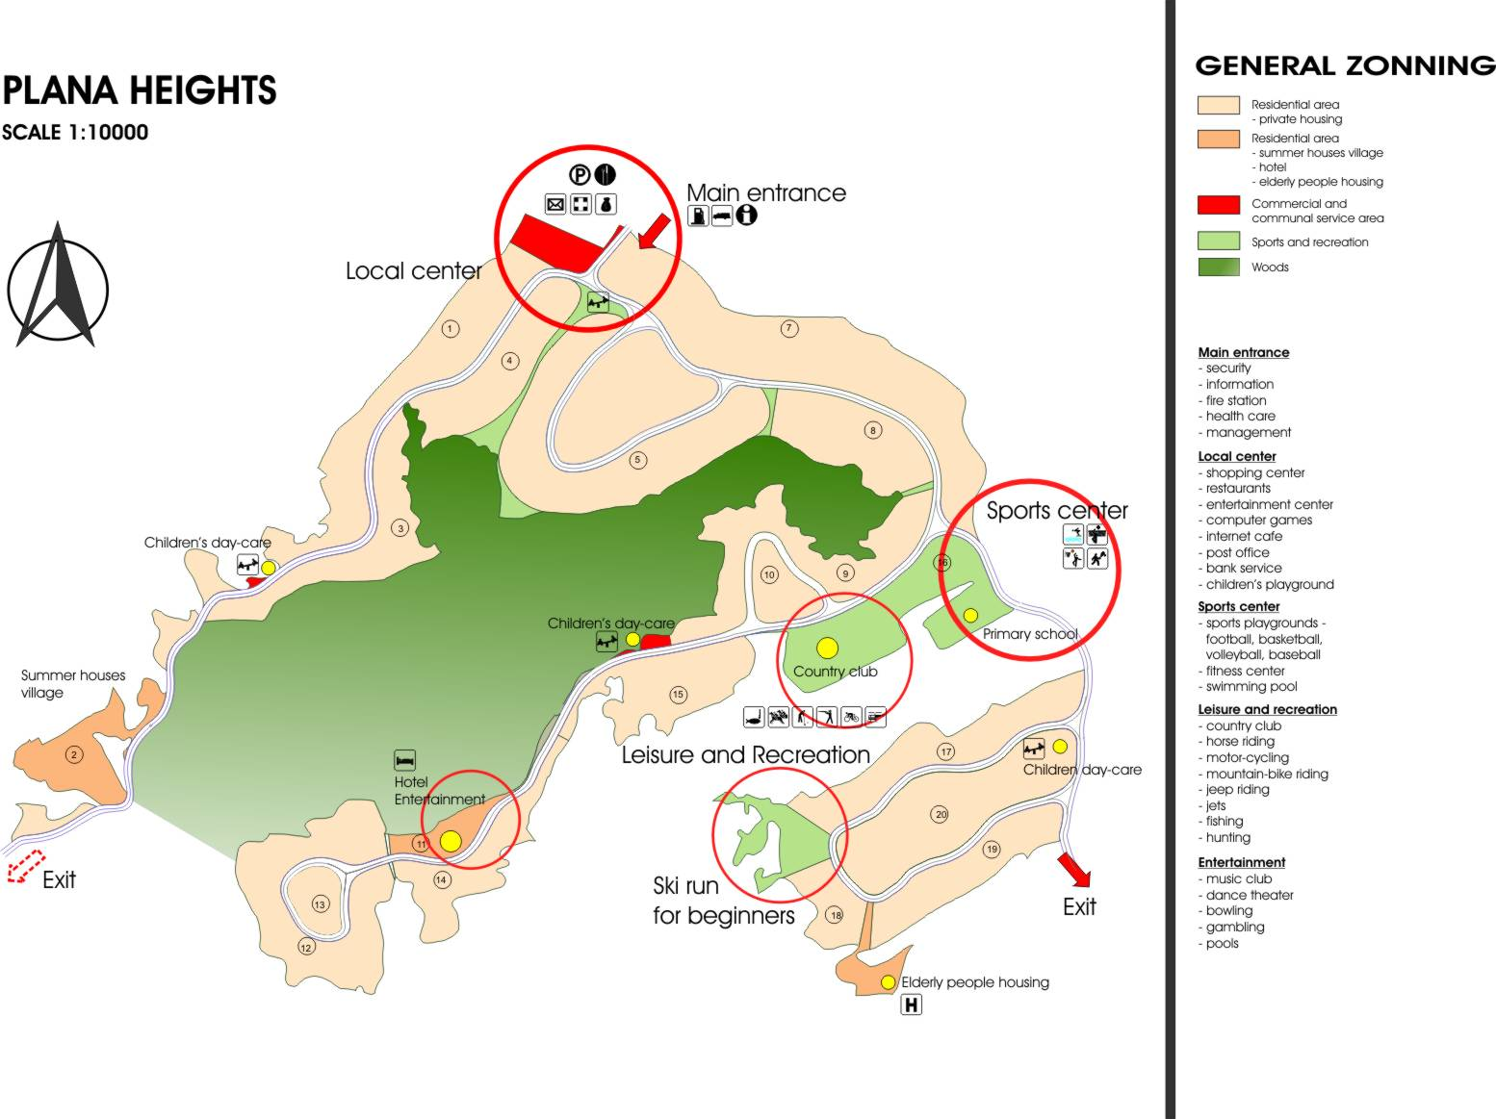

Slide 18
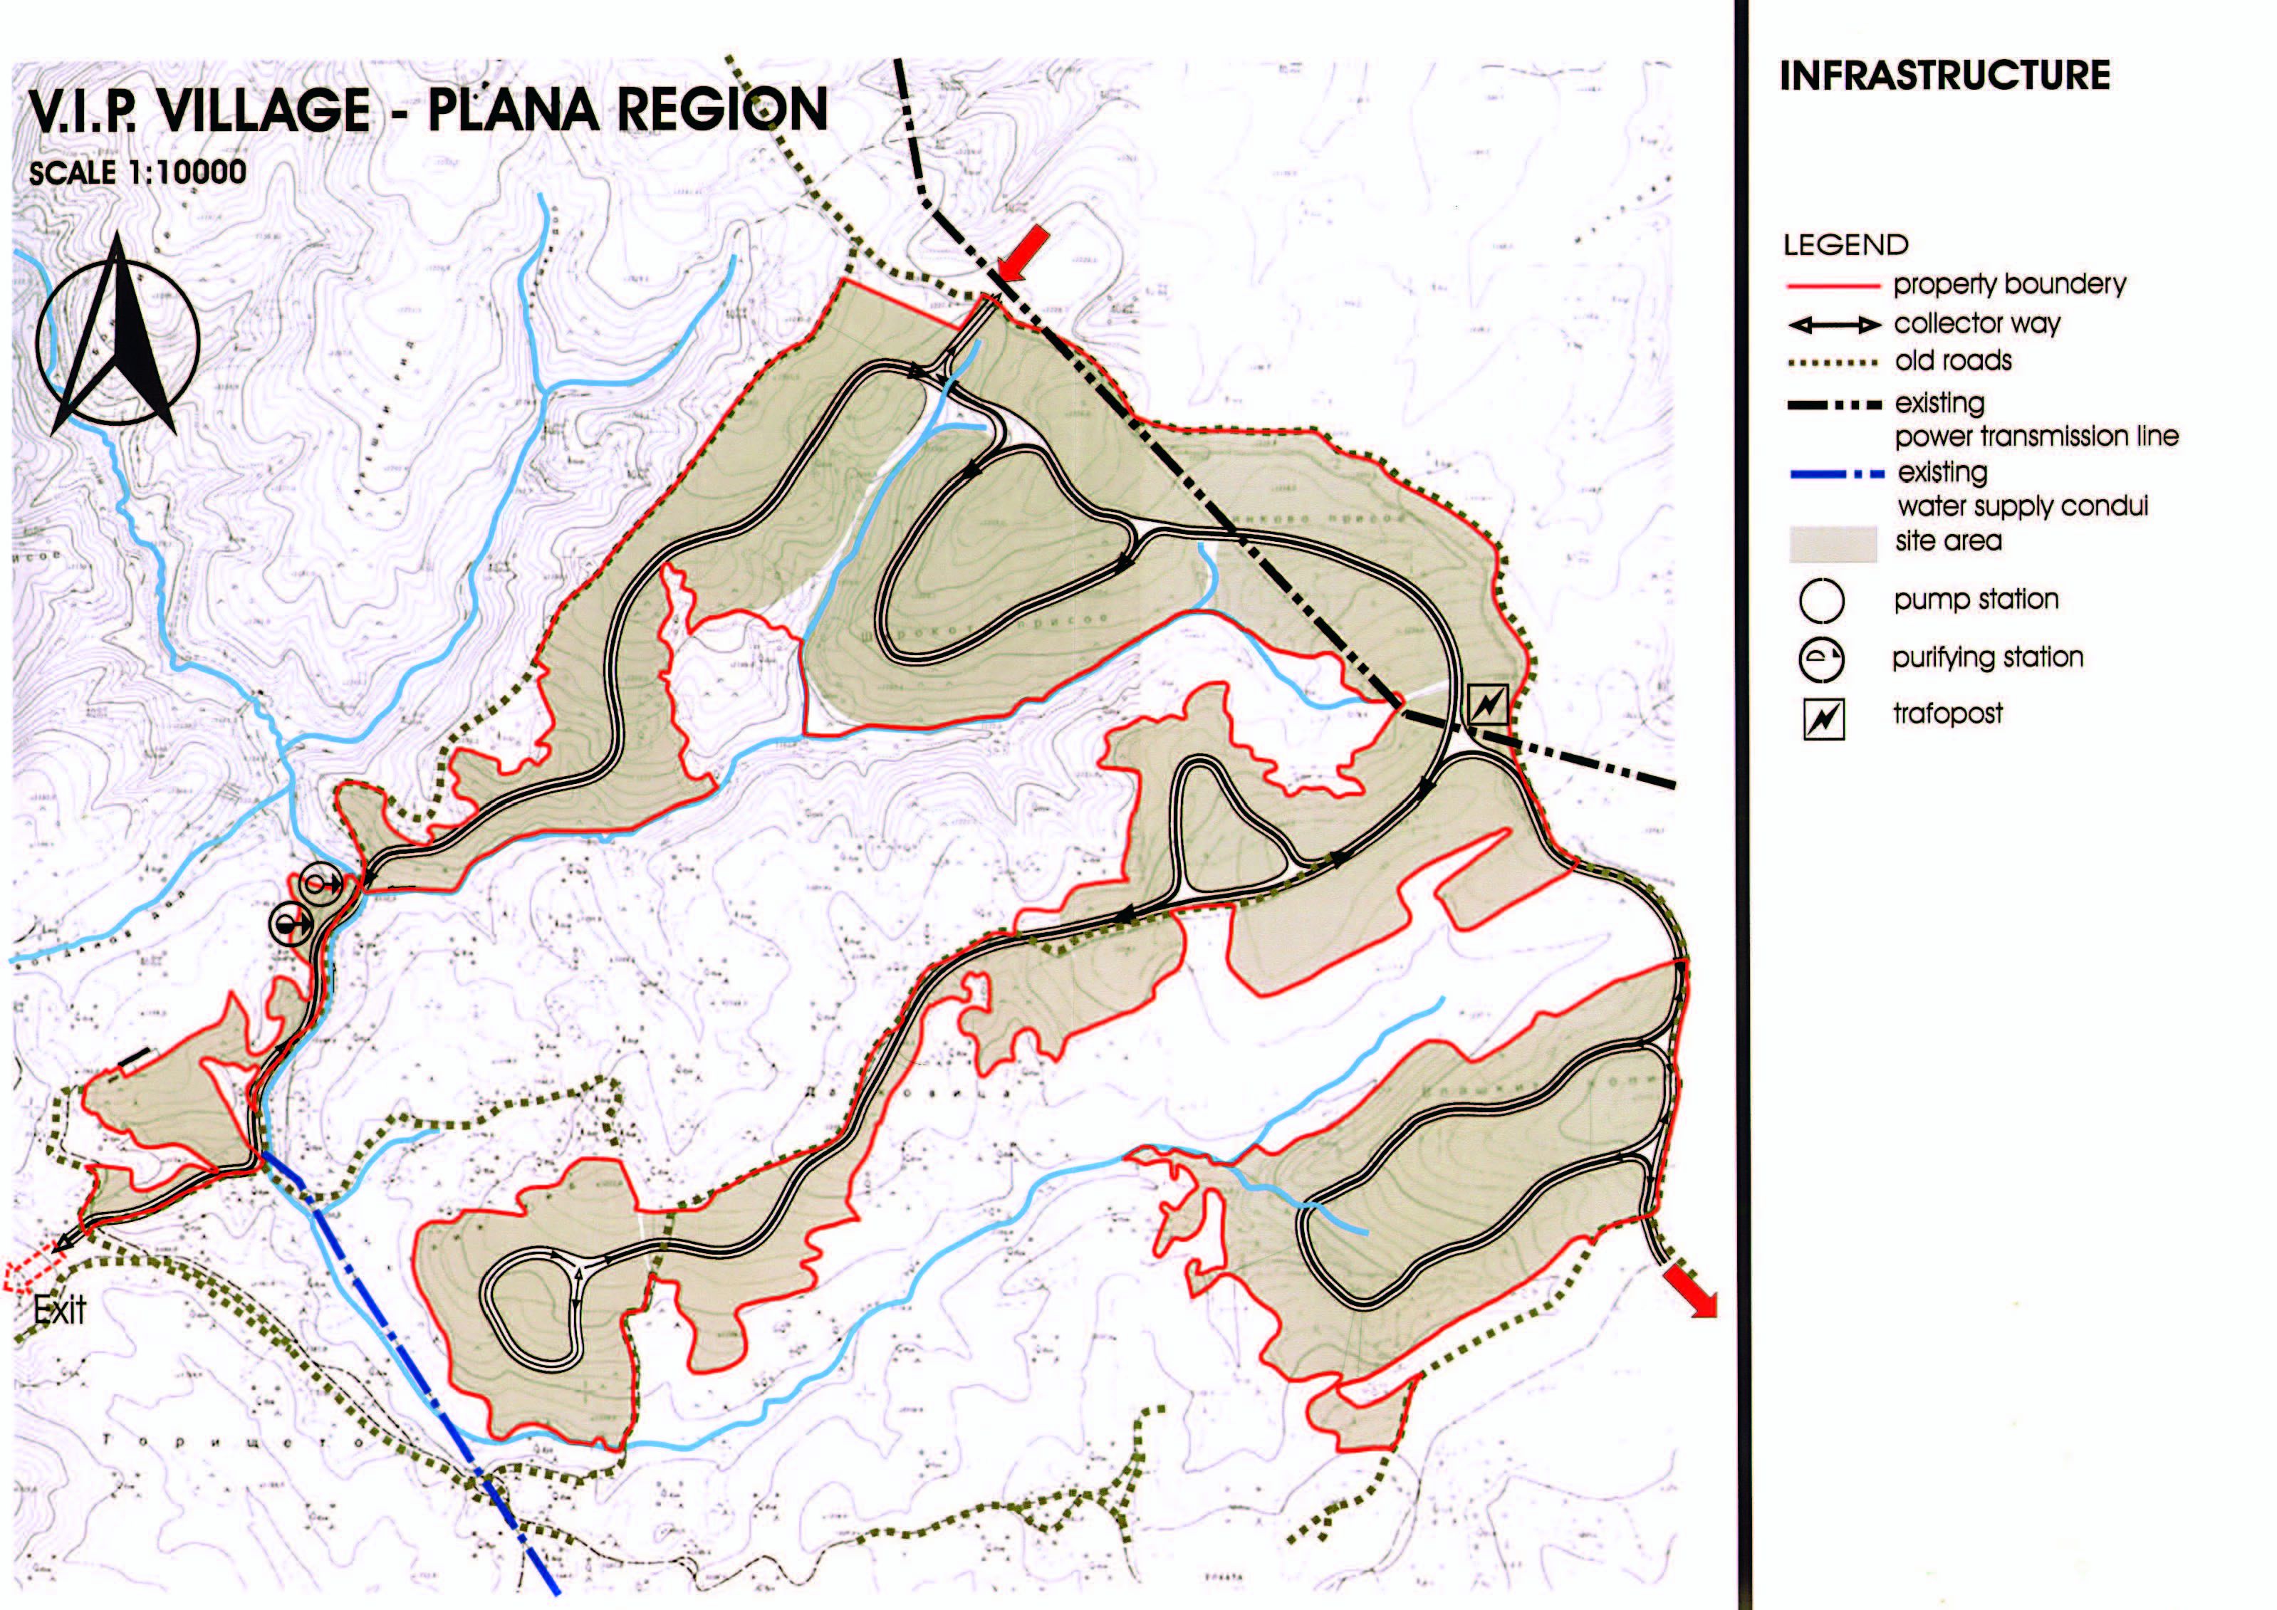

Slide 19
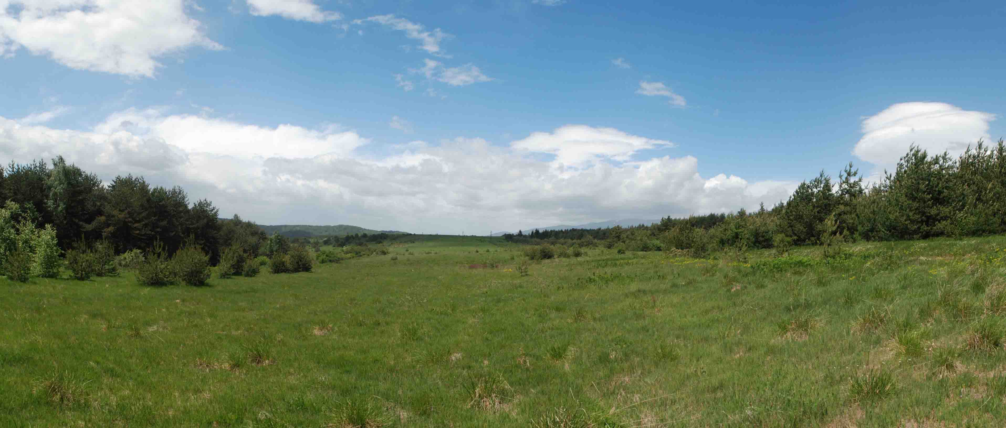

Slide 20
